Slide 1
Practice slideshow

Slide 2

Save a copy of this slideshow
Save your own copy of this slideshow before you start making an experimental magazine cover.
Steps:
  top tool bar
  File
  Save as
  change the file name to include your name, for example:
ExperimentMag_YourName.pptx
  select a location for where to save the slideshow
  save.
SS

Slide 3
You can experiment with these techniques on the next two slides.
Instructions and the images and sounds that can be used are around the outside of the slides.
Set the zoom level to 50% to access them.
Zoom control is in the bottom right corner of your screen.

Slide 4
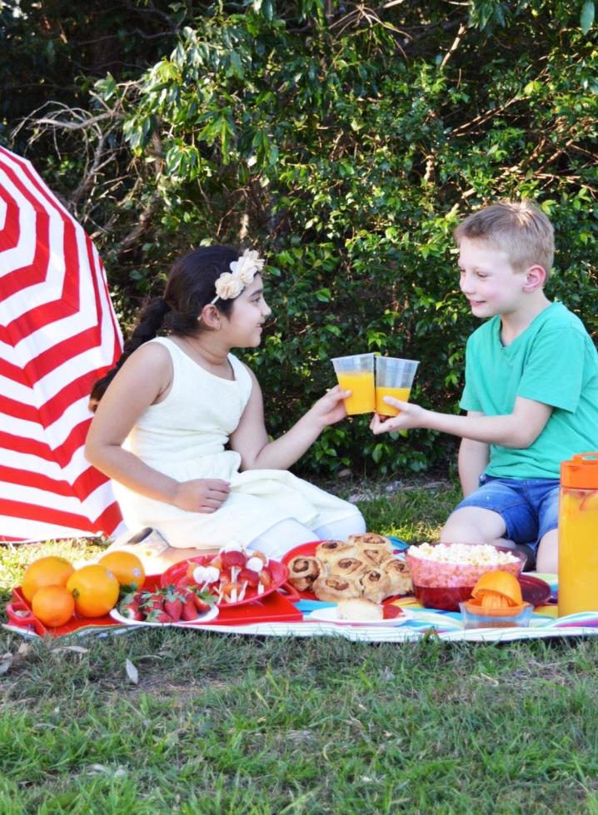

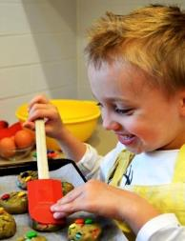
Use these image, sound and text features to experiment with page layout design using the tools in this slideshow program.
Remember …
  click and drag to reposition
  right click to find tool panel
  search for tools in top tool bar
  click on an image or text box to re-size using handles.
  Ungroup images, shapes and text boxes to re-format.
kitchen kids
summer 2015 issue 01
click speakers to listen
easy
school’s out!
pizza
summer holiday treats
best
party
biscuits
favourites
ever
make
cupcake cases

Slide 5
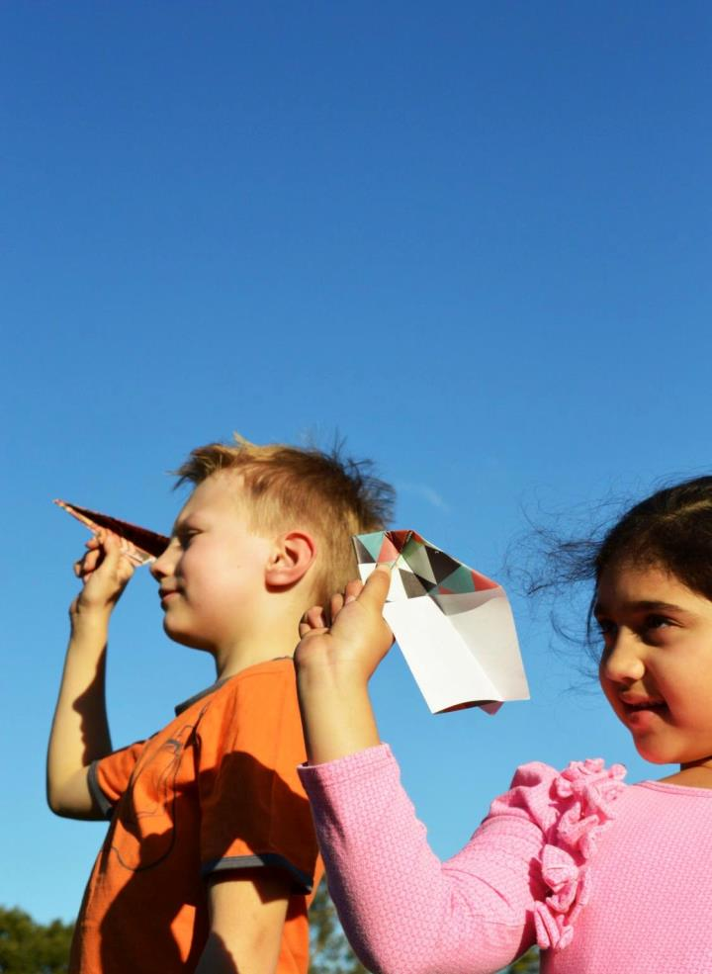
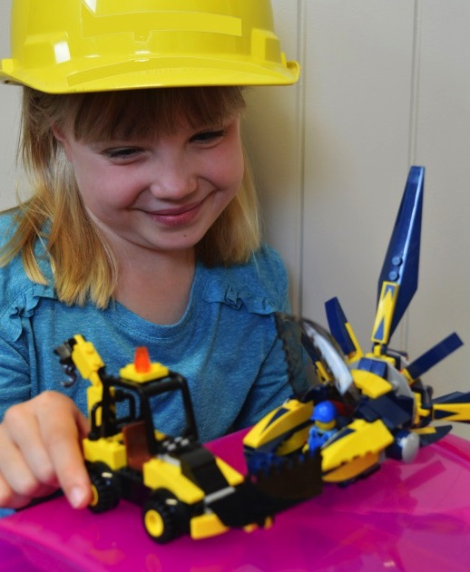
Use these image, sound and text features to experiment with page layout design using the tools in this slideshow program.
Remember …
  click and drag to reposition
  right click to find tool panel
  search for tools in top tool bar
  click on an image or text box to re-size using handles.
  Ungroup images, shapes and text boxes to re-format.
Silly
Weekend
slime
games
The science of bubbles
Creative
constructions
Click speakers to listen
Aerodynamic paper
Patterns for paper aeroplanes
Spring 2015 Issue 01
Make your
own
fun

Slide 6
Save your experimental cover
Save your experimental electronic magazine cover.
Saving your cover as a slideshow presentation will allow you to play the sound and to make more edits in the future.
Saving your cover as an image (JPEG) will only allow you to see the image and text.
SS
JPEG
All persons appearing in this resource do so with consent.

